Slide 1
Chapter Three
Analyzing the Marketing Environment

Slide 2
Analyzing the Marketing Environment
Topic Outline
The Company’s Microenvironment
The Company’s Macroenvironemnt
The Demographic Marketing Environment
The Economic Environment
The Natural Environment
The Technological Environment
The Political and Social Environment
The Cultural Environment
Responding to the Marketing Environment

Slide 3
The Marketing Environment
The marketing environment includes the actors and forces outside marketing that affect marketing management’s ability to build and maintain successful relationships with customers

Slide 4
The Marketing Environment
Microenvironment consists of the actors close to the company that affect its ability to serve its customers, the company, suppliers, marketing intermediaries, customer markets, competitors, and publics

Slide 5
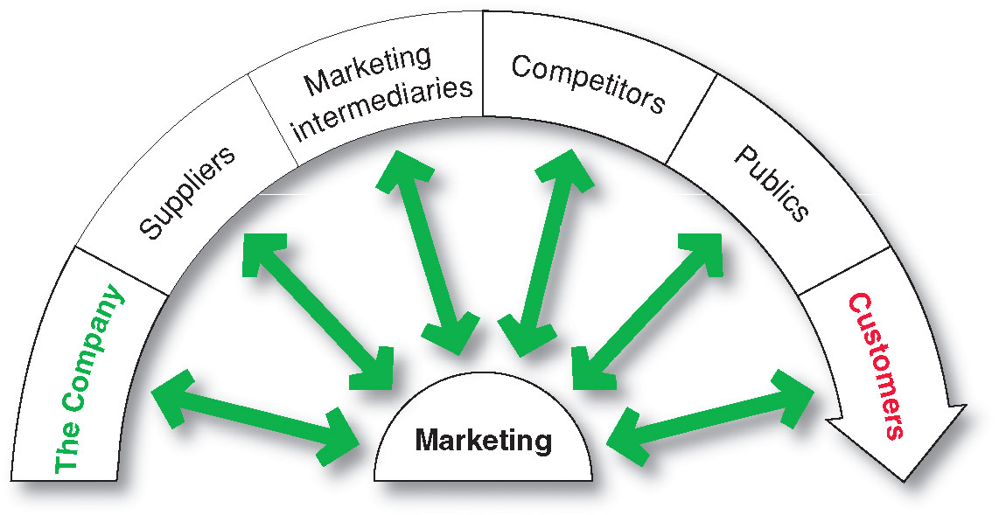
The Company’s Microenvironment
Actors in the Microenvironment

Slide 6
The Company’s Microenvironment
The Company
Top management
Finance
R&D
Purchasing
Operations
Accounting
Notes:
Note to Instructor
Discussion Questions
What types of collaboration do there need to be between the departments?
How might projects be integrated between marketing and finance?
How might projects be integrated between marketing and information systems?
This question on finance could lead to a discussion about budgeting for marketing. The collaboration between marketing and IS could lead to discussions of market research, ordering systems, and customer relationship management systems.

Slide 7
The Company’s Microenvironment
Suppliers
Provide the resources to produce goods and services
Treat as partners to provide customer value

Slide 8
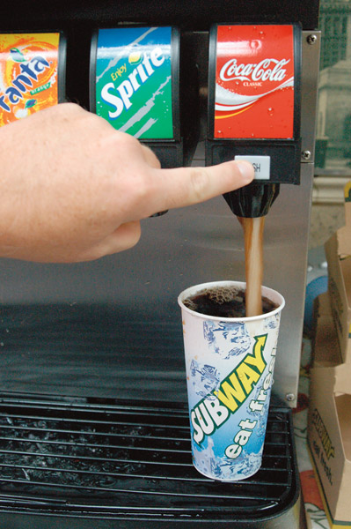
The Company’s Microenvironment
Marketing Intermediaries
Help the company to promote, sell and distribute its products to final buyers
Notes:
Note to Instructor
The text explains how Coke delivers value for their marketing intermediaries:
They understand each retailer partner’s business
The conduct consumer research and share with partners
They develop marketing programs and merchandising for partners

Slide 9
The Company’s Microenvironment
Types of Marketing Intermediaries
Notes:
Resellers are distribution channel firms that help the company
find customers or make sales to them.
Physical distribution firms help the company stock and move goods from their points of
origin to their destinations.
Marketing services agencies are the marketing research firms, advertising
agencies, media firms, and marketing consulting firms that help the company target and
promote its products to the right markets.
Financial intermediaries include banks, credit companies,
insurance companies, and other businesses that help finance transactions
or insure against the risks associated with the buying and selling of goods.

Slide 10
The Company’s Microenvironment
Competitors
Firms must gain strategic advantage by positioning their offerings against competitors’ offerings
Notes:
Note to Instructor
Students should note that the competition is just a click away with online purchasing. This link goes to Bizrate—one of many comparison shopping sites online. Enter a product like coffee makers to see the competing products and retailers for this category.

Slide 11
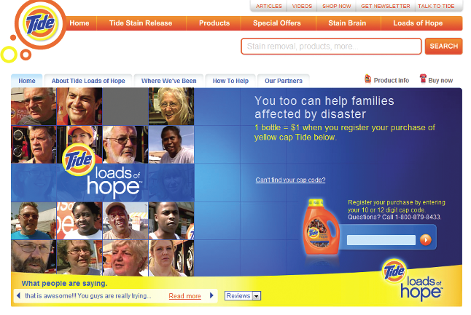
The Company’s Microenvironment
Publics
Any group that has an actual or potential interest in or impact on an organization’s ability to achieve its objectives
Financial publics
Media publics
Government publics
Citizen-action publics
Local publics
General public
Internal publics

Slide 12
The Company’s Microenvironment
Customers
Consumer markets
Business markets
Government markets
International markets
Notes:
Consumer markets consist of individuals.
Business markets buy goods and services for further
processing or use in their production processes, whereas reseller markets buy goods and
services to resell at a profit.
Government markets consist of government agencies that buy goods
and services to produce public services or transfer the goods and services to others who need
them.
International markets consist of these buyers in other countries, including consumers,
producers, resellers, and governments. Each market type has special characteristics
that call for careful study by the seller.

Slide 13
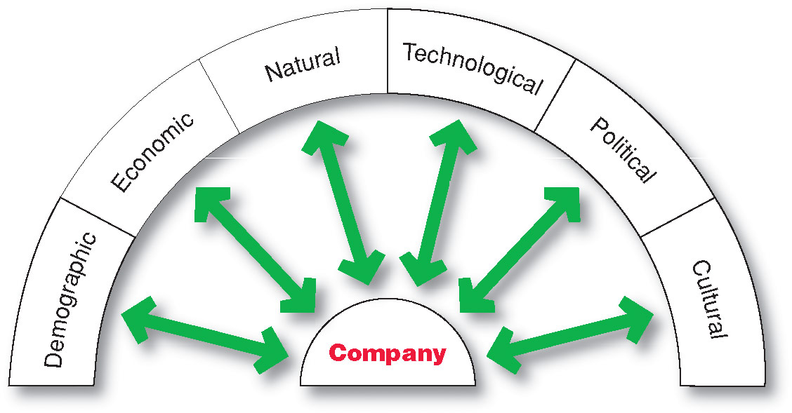
The Company’s Macroenvironment

Slide 14
The Company’s Macroenvironment
Demographic Environment
Demography: the study of human populations-- size, density, location, age, gender, race, occupation, and other statistics
Demographic environment: involves people, and people make up markets
Demographic trends: shifts in age, family structure, geographic population, educational characteristics, and population diversity

Slide 15
The Company’s Macroenvironment
Demographic Environment
Changing age structure of the population
Baby boomers include people born between 1946 and 1964
Most affluent Americans
Notes:
Note to Instructor
There are many Web sites targeted to boomers including this link to Boomers International. Before following the link it might be interesting to ask the following:
Discussion Questions
What type of information boomers might be seeking?

Slide 16
The Company’s Macroenvironment
Demographic Environment
Generation X includes people born between 1965 and 1976
High parental divorce rates
Cautious economic outlook
Less materialistic
Family comes first

Slide 17
The Company’s Macroenvironment
Demographic Environment
Millennials (gen Y or echo boomers) include those born between 1977 and 2000
Comfortable with technology
Tweens (ages 8–12)
Teens (13–19)
Young adults (20’s)

Slide 18
The Company’s Macroenvironment
Demographic Environment
Generational marketing is important in segmenting people by lifestyle of life state instead of age

Slide 19
The Company’s Macroenvironment
Demographic Environment
More people are:
Divorcing or separating
Choosing not to marry
Choosing to marry later
Marrying without intending to have children
Increasing number of working women
Increasing number of stay-at-home dads

Slide 20
The Company’s Macroenvironment
Demographic Environment
Growth in U.S. West and South and decline in Midwest and Northeast
Move from rural to metropolitan areas
Change in where people work
Telecommuting
Home office
Notes:
Ask the students
Why do they think these geographic shifts in population are happening.
Where will they choose to live when they finish their education, and why would they make the choice?

Slide 21
The Company’s Macroenvironment
Demographic Environment
Changes in the Workforce
More educated
More white collar
Notes:
Note to Instructor
Students are probably very familiar with job search sites such as this link to monster.com. It might be interesting to compare the listings for white collar versus blue collar job opportunities including the associated pay and benefits.

Slide 22
The Company’s Macroenvironment
Demographic Environment
Increased Diversity
Markets are becoming more diverse
International
National
Includes:
Ethnicity
Gay and lesbian
Disabled

Slide 23
The Company’s Macroenvironment
Economic Environment
Economic environment consists of factors that affect consumer purchasing power and spending patterns
Industrial economies are richer markets
Subsistence economies consume most of their own agriculture and industrial output
Notes:
The economic
environment can offer
both opportunities and threats. For
example, facing a still-uncertain
economy, luxury car maker Infiniti now
promises to “make luxury affordable.”

Slide 24
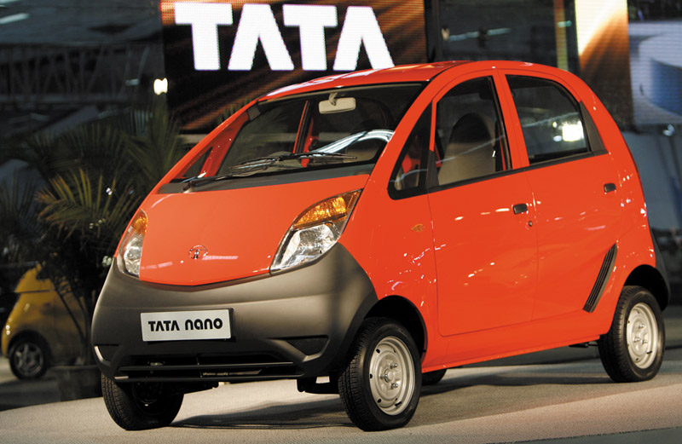
The Company’s Macroenvironment
Economic Environment
Value marketing
offering financially cautious buyers greater value—
the right combination of quality and service at a fair price
Notes:
Note to Instructor
This graphic highlights a car targeted to India’s growing middle class.
Discussion Questions
What changes might there be in U.S. income over the next year? What are positioned as “value cars.”
The students might quote current economic declines or rises. The “value cars” will probably include some of the smaller cars by Kia, Ford, Honda, and Toyota.

Slide 25
The Company’s Macroenvironment
Natural Environment
Natural environment: natural resources that are needed as inputs by marketers or that are affected by marketing activities
Trends
Increased shortages of raw materials
Increased pollution
Increased government intervention
Increased environmentally sustainable strategies
Notes:
Note to Instructor
This Web link connects to greenbiz.com. There are several Web sites like this that provide information on business as to how to practice green strategies including green marketing.
GE is using its “ecomagination” to create products for a better world—cleaner
aircraft engines, cleaner locomotives, cleaner fuel technologies. Taken together, for instance, all
the GE Energy wind turbines in the world could produce enough power for 2.4 million U.S.
homes. And in 2005, GE launched its Evolution series locomotives, diesel engines that cut fuel
consumption by 5 percent and emissions by 40 percent compared to locomotives built just a year
earlier. Up next is a triumph of sheer coolness: a GE hybrid diesel-electric locomotive that, just
like a Prius, captures energy from braking and will reduce fuel consumption by 15 percent and
emissions by as much as 50 percent compared to most locomotives in use today.

Slide 26
The Company’s Macroenvironment
Technological Environment
Most dramatic force in changing the marketplace
New products, opportunities
Concern for the safety of new products
Notes:
Note to Instructor
Discussion Question
Ask students what changes they have seen in technology in the past four years including medical products, communications, and media.
They will most likely talk about the use of artificial organs and stem cell research, the growth of PDA’s like the iPod, and the use of new media products including DVR or TiVo.

Slide 27
The Company’s Macroenvironment
Political and Social Environment
Political environment
laws, government agencies, and pressure groups that influence or limit various organizations and individuals in a given society

Slide 28
The Company’s Macroenvironment
Political and Social Environment
Legislation regulating business
Increased legislation
Changing government agency enforcement
Increased emphasis on ethics
Socially responsible behavior
Cause-related marketing

Slide 29
The Company’s Macroenvironment
Cultural Environment
Cultural environment consists of institutions and other forces that affect a society’s basic values, perceptions, and behaviors
Notes:
Cultural factors strongly
affect how people think
and how they consume. So marketers
are keenly interested in the cultural

Slide 30
The Company’s Macroenvironment
Cultural Environment
Persistence of Cultural Values
Core beliefs and values are persistent and are passed on from parents to children and are reinforced by schools, churches, businesses, and government
Secondary beliefs and values are more open to change and include people’s views of themselves, others, organization, society, nature, and the universe

Slide 31
The Company’s Macroenvironment
Cultural Environment
Shifts in Secondary Cultural Values
People’s view of themselves
People vary in their emphasis on
serving themselves versus serving others.
People’s view of others
More “cocooning” – staying home, home cooked meals
Notes:
Note to Instructor
.

Slide 32
The Company’s Macroenvironment
Cultural Environment
Shifts in Secondary Cultural Values
People’s view of organizations
Decline of loyalty toward companies
People’s view of society
Patriots defend it
Reformers want to change it
Malcontents want to leave it

Slide 33
The Company’s Macroenvironment
Cultural Environment
Shifts in Secondary Cultural Values
People’s view of nature
Some feel ruled by it
Some feel in harmony with it
Some seek to master it
People’s view of the universe
Renewed interest in spirituality
Developed more permanent values
family, community, earth, faith, ethics
Notes:
Ask the students about their cultural values regarding nature and the universe. Do they see a difference between what the student values versus what their parents value?

Slide 34
Responding to the Marketing Environment
Views on Responding
Notes:
Rather than simply
watching and reacting,
companies should take proactive steps
with respect to the marketing
environment.

Slide 35
All rights reserved. No part of this publication may be reproduced, stored in a retrieval system, or transmitted, in any form or by any means, electronic, mechanical, photocopying, recording, or otherwise, without the prior written permission of the publisher. Printed in the United States of America.
Copyright © 2012 Pearson Education, Inc.
Publishing as Prentice Hall

