Slide 1
Chapter Six
Business Markets and Business Buying Behavior

Slide 2
Business Markets and Business Buying Behavior
Topic Outline
Business Markets
Business Buyer Behavior
The Business Buying Process
E-Procurement: Buying on the Internet
Institutional and Government Markets

Slide 3
Business Markets
Business buyer behavior refers to the buying behavior of the organizations that buy goods and services for use in production of other products and services that are sold, rented, or supplied to others.
Business buying process is the process where business buyers determine which products and services are needed to purchase, and then find, evaluate, and choose among alternative brands

Slide 4
Business Markets
Market Structure and Demand
Notes:
Derived demand
Business demand that ultimately comes
from (derives from) the demand for
consumer goods.
inelastic demand; that is, the total demand
for many business products is not much affected by price changes, especially
in the short run. A drop in the price of leather will not cause shoe manufacturers
to buy much more leather unless it results in lower shoe prices that, in
turn, will increase the consumer demand for shoes.
fluctuating demand. The demand for
many business goods and services tends to change more—and more quickly—
than the demand for consumer goods and services does. A small percentage
increase in consumer demand can cause large increases in business demand.
Sometimes a rise of only 10 percent in consumer demand can cause as much
as a 200 percent rise in business demand during the next period.
buyer and seller are often much more dependent
on each other. B-to-B marketers may roll up their sleeves and work closely with their
customers during all stages of the buying process—from helping customers define problems,
to finding solutions, to supporting after-sale operation. They often customize their offerings
to individual customer needs.

Slide 5
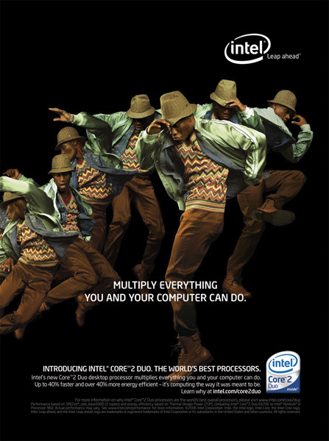
Business Markets Decision Process
More complex
More decision participants
More professional purchasing effort

Slide 6
Business Markets
Decision Process
Supplier development
systematic development of networks of supplier-partners to ensure an appropriate and dependable supply of products and materials that they will use in making their own products or resell
Notes:
Note to Instructor
The IKEA example in the text is excellent on understanding the importance of supplier development:
IKEA challenge is finding enough of the right kinds of suppliers to help design and produce the billions of dollars of affordable goods.
IKEA currently relies on about 1,800 suppliers in more than 50 countries to stock its shelves.
If the giant retailer continues at its current growth rate, it will need to double its supply network by 2010.
IKEA doesn’t just buy from its suppliers. It involves them deeply in the process of designing and making stylish but affordable furniture.

Slide 7
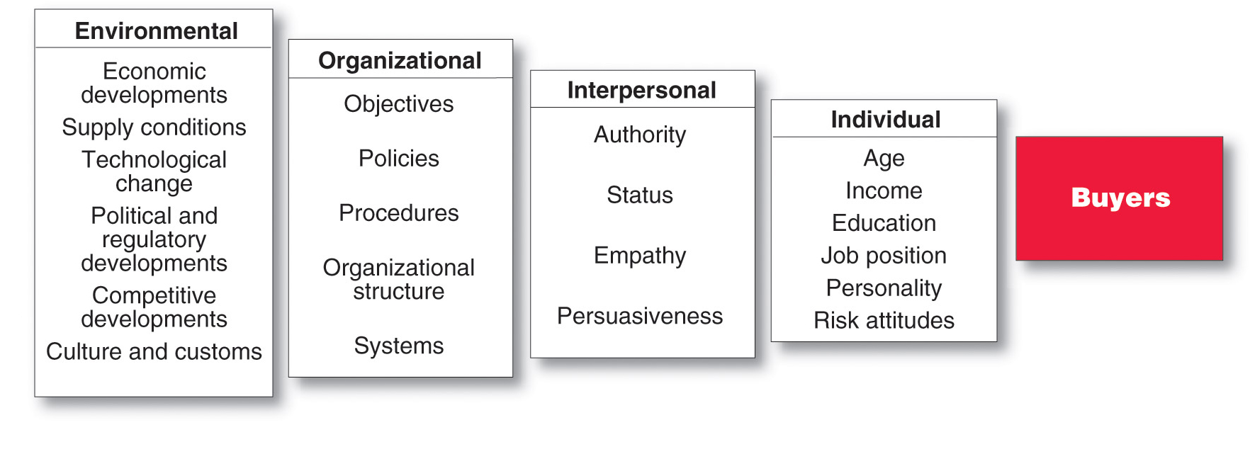
Business Buyer Behavior
The Model of Business Buyer Behavior
Notes:
Note to Instructor
In some ways, business markets are similar
to consumer markets—this model looks a lot
like the model of consumer buyer behavior
presented in Figure 5.1. But there are some
major differences, especially in the nature of
the buying unit, the types of decisions made,
and the decision process.
Discussion Question
How would the purchase of a chair like the one you are sitting in be different for the University versus an end consumer like yourself buying a chair for your desk?
It may be difficult for students with no business buying experience to grasp the difference between business and consumer buying. Students will note how the university needs to buy more, that they need to ask users about the chairs, that they will organize more intricately for the buying effort, that they will work with the vendors for reduced prices for bulk purchases. In addition, this can tie directly to the major types of buying situations.
Discussion Questions
How could the chair be a straight rebuy versus a modified rebuy. What implications would the different situation make on the process?

Slide 8
Business Buyer Behavior
Major Types of Buying Situations
Straight rebuy is a routine purchase decision such as reorder without any modification
Modified rebuy is a purchase decision that requires some research where the buyer wants to modify the product specification, price, terms, or suppliers
New task is a purchase decision that requires thorough research such as a new product

Slide 9
Business Buyer Behavior
Major Types of Buying Situations
Systems selling
involves the purchase
of a packaged solution
from a single seller

Slide 10
Business Buyer Behavior
Participants in the Business Buying Process
Buying center is all of the individuals and units that participate in the business decision-making process
Users
Influencers
Buyers
Deciders
Gatekeepers

Slide 11
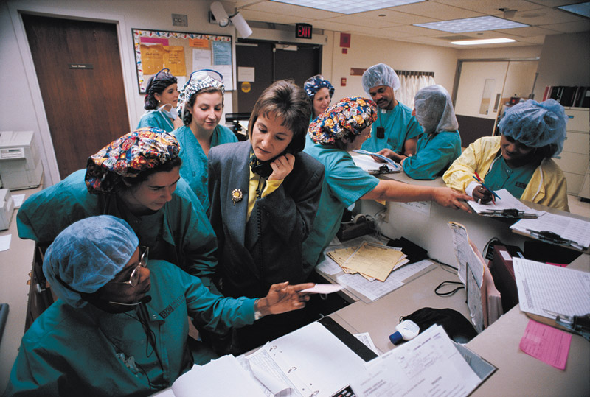
Business Buyer Behavior
Participants in the Business Buying Process
Buying center provides a major challenge
Who participates in the process
Their relative authority
What evaluation criteria each participant uses
Informal participants

Slide 12
Business Buyer Behavior
Participants in the Business Buying Process
Users are those that will use the product or service
Influencers help define specifications and provide information for evaluating alternatives
Buyers have formal authority to select the supplier and arrange terms of purchase
Deciders have formal or informal power to select and approve final suppliers
Gatekeepers control the flow of information

Slide 13
Business Buyer Behavior
Major Influences on Business Buyers

Slide 14
Business Buyer Behavior
Major Influences on Business Buyers
Environmental Factors
Notes:
Note to Instructor
This Web link goes to the American Enterprise Institute’s economic outlook newsletter. There are other economic indicators that might be interesting to draw to the students attention including GDP and CPI.

Slide 15
Business Buyer Behavior
Major Influences on Business Buyers Organizational Factors

Slide 16
Business Buyer Behavior
Major Influences on Business Buyers
Individual Factors

Slide 17
Business Buyer Behavior
The Buying Process
Notes:
Buyers facing new, complex buying
decisions usually go through all of
these stages. Those making rebuys
often skip some of the stages. Either
way, the business buying process is
usually much more complicated than
this simple flow diagram suggests

Slide 18
Business Buyer Behavior
The Buying Process
Problem recognition occurs when someone in the company recognizes a problem or need
Internal stimuli
Need for new product or production equipment
External stimuli
Idea from a trade show or advertising

Slide 19
Business Buyer Behavior
The Buying Process
General need description describes the characteristics and quantity of the needed item
Product specification describes the technical criteria
Value analysis is an approach to cost reduction where components are studied to determine if they can be redesigned, standardized, or made with less costly methods of production

Slide 20
Business Buyer Behavior
The Buying Process
Supplier search involves compiling a list of qualified suppliers
Proposal solicitation is the process of requesting proposals from qualified suppliers
Notes:
Note to Instructor
This Web link brings the class to IDES which is a search engine for suppliers. The current page shows the vast number of plastics suppliers.

Slide 21
Business Buyer Behavior
The Buying Process
Supplier selection is the process when the buying center creates a list of desired supplier attributes and negotiates with preferred suppliers for favorable terms and conditions
Order-routine specifications is the final order with the chosen supplier and lists all of the specifications and terms of the purchase
Notes:
Note to Instructor
This Web link brings you to staples.com, a leading supplier of office supplies for business and end consumers. It would be interesting to ask students what Staples can do to market themselves more effectively to businesses so they become the sole supplier of office products.

Slide 22
Business Buyer Behavior
The Buying Process
Performance review involves a critique of supplier performance to the purchase terms

Slide 23
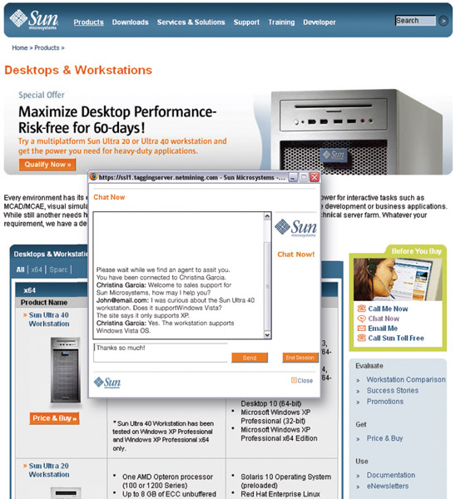
Business Buyer Behavior
E-Procurement
Online purchasing
Company-buying sites
Extranets

Slide 24
Business Buyer Behavior
E-Procurement
Advantages
Access to new suppliers
Lowers costs
Speeds order processing and delivery
Shares information
Sales
Service and support
Disadvantages
Can erode relationships as buyers search for new suppliers
Security

Slide 25
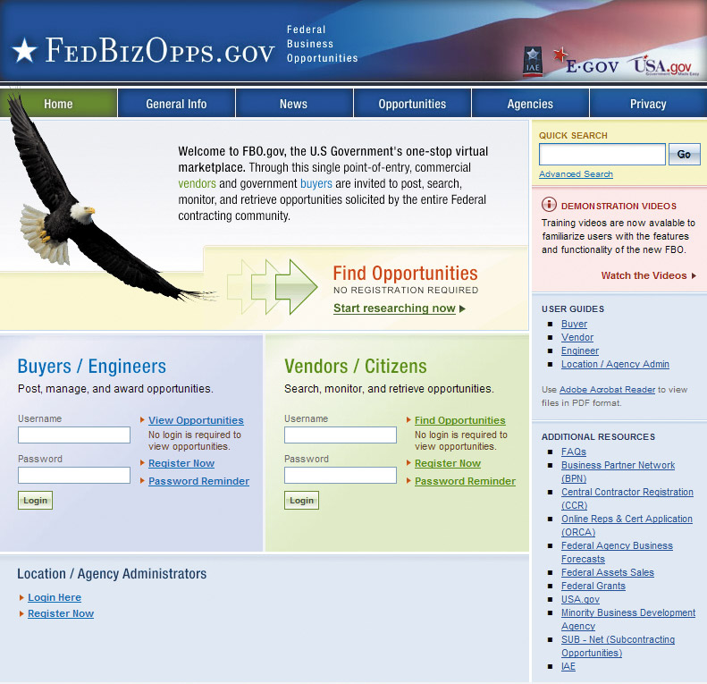
Institutional and Government Markets
Institutional markets consist of hospitals, nursing homes, and prisons that provide goods and services to people in their care
Characteristics
Low budgets
“Captive” audience
Notes:
Note to Instructor
Institutional markets are larger than the students initially may believe as given in this prison example:
The nation has 2 million inmates and are the ultimate captive market —a $37 billion economy bulging with opportunity.
State prison systems spend more than $30 billion annually, and the Federal Bureau of Prisons budget another $5 billion.
There is an opportunity for vendors including security, medicine, education, food service, maintenance, and technology.

Slide 26
Institutional and Government Markets
Government markets
tend to favor domestic suppliers and require suppliers to submit bids and normally award to the lowest bidder
Affected by environmental factors
Non-economic factors considered
Minority suppliers
Depressed suppliers
Small businesses

Slide 27
All rights reserved. No part of this publication may be reproduced, stored in a retrieval system, or transmitted, in any form or by any means, electronic, mechanical, photocopying, recording, or otherwise, without the prior written permission of the publisher. Printed in the United States of America.
Copyright © 2012Pearson Education, Inc.
Publishing as Prentice Hall

