Slide 1
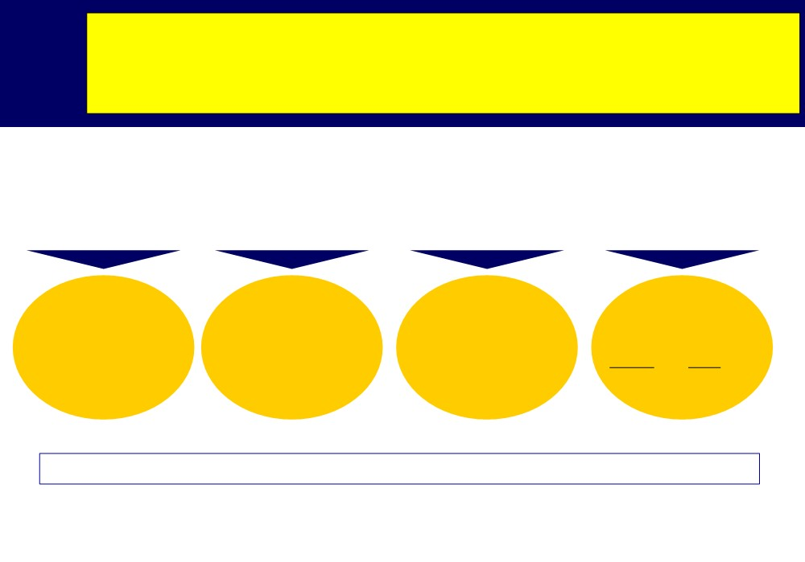
A Brand is: name, term, sign, symbol, design, or combination of these.
Brand
Brand: derived from the old Norse word “brander” which means “to burn.”
Brand Name
Brand mark Trademark
Copyright
Vocalized part of the brand...
Symbol, design, Part of the brand color, letters given legal
Legal right to reproduce,
Tide, Avon, Chevrolet, Disneyland,
Pillsbury doughboy, protection to
publish and sell the matter and form of a
MGM Lion, brand name K on Kodak box or brand mark
literary musical or artistic work
AMEX
The process of branding encompasses all elements of the brand...

Slide 2
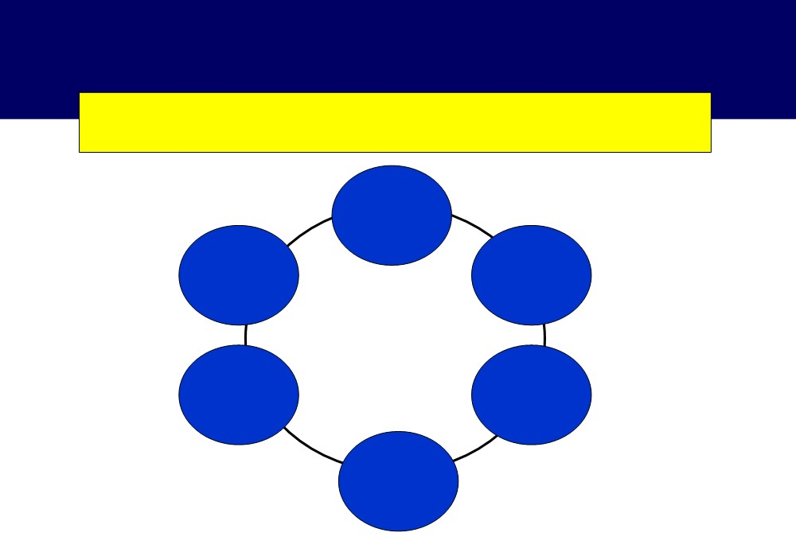
Brand Introductions and Growth
The level of marketing effort supporting brand introduction depends on ...
Product
quality
Growth
Firm
rate of
familiarity
the
with the
market
market
Size of the
Firm’s
market
resources
Low market concentration

Slide 3
Findings on Brand introductions
Managers should expect better results in terms of market share in markets where a limited number of brands hold a large share which renders such market more
1
attractive to new brands
2
A new brand should be supported with a larger effort when introduce into a fast growing market than when the market is mature
The amount of communication effort used to introduce a brand depends on only one manufacturer characteristic--the availability of resources
3

Slide 4
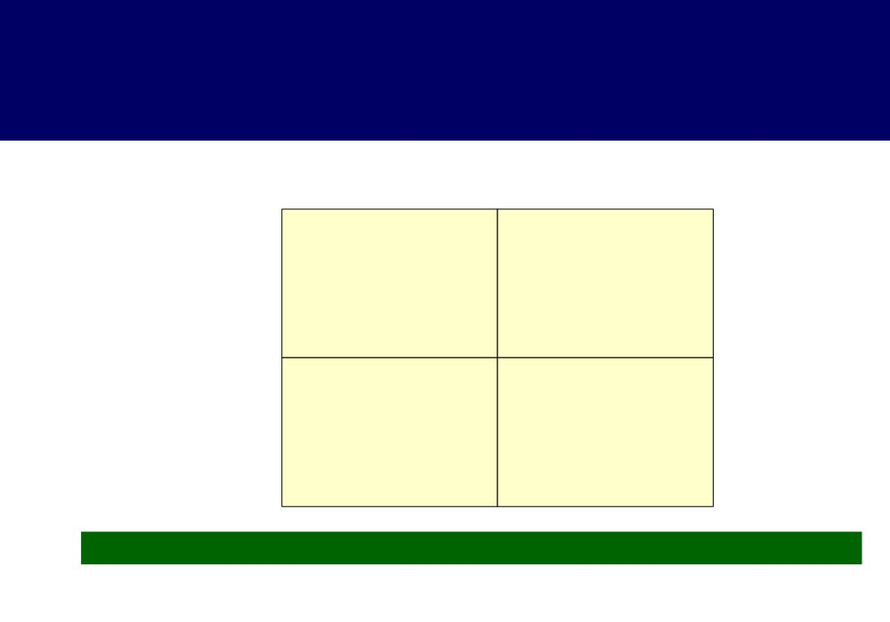
Why does branding become critical ?
Involvement in
High
purchase
Low
Consumer sees
differences in brands
Complex buying behavior
Variety seeking buying
behaviour
Consumer does not see differences in brands
Dissonance reducing buying
Habitual buying behaviour
behaviour
In which of these quadrants is branding most critical? And why?

Slide 5
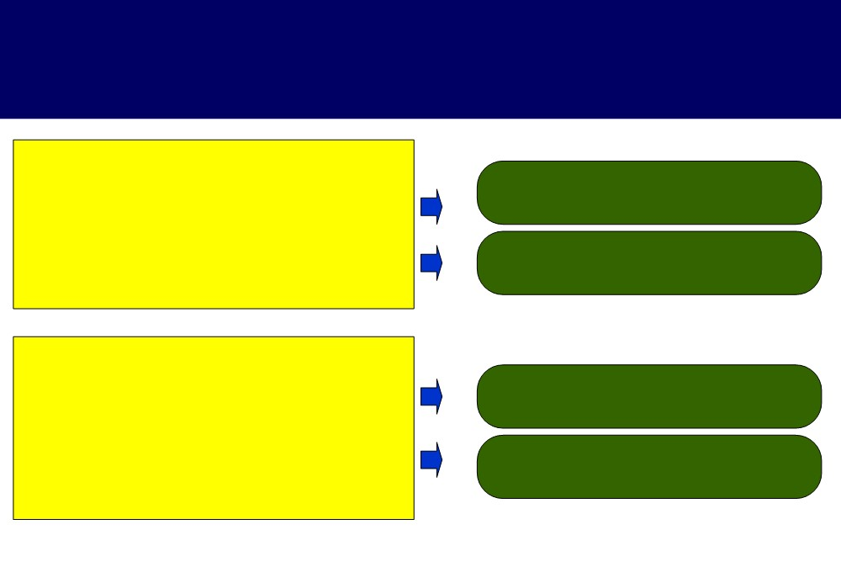
Strategic question in branding...
 What does the consumer see as the significance of brand?
Salience / strengths of the brand
The reputation of the firm & Buyer image
 Who should brand and own the brand?
 What risks does the consumer see?
The risk could be high price , product failure, lack of after sales etc.
 What information does the consumer needs?
Reputation , past sales, comparative brand price and service etc

Slide 6
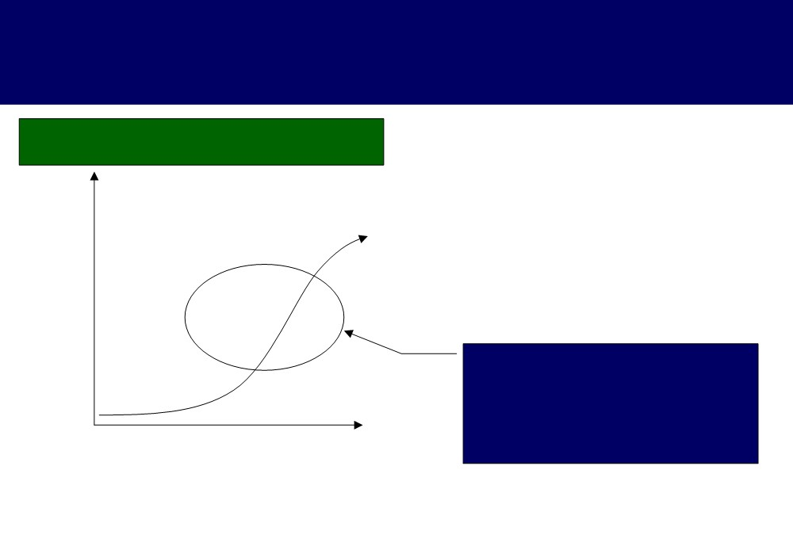
How does the mechanics of branding work?
A typical communication build up
High
Action
Involvement in the
Desire
decision
Interest
Awareness is an Advertising based activity ...
Awareness
Low
however, branding focuses on building Interest and Desire to try the product
Low Transactional High
completeness

Slide 7
Strong brands v/s Weak brands
The level of memory recall
Memory
Top of the mind
Unaided recall for the brand
Aided recall for the brand
Memory of the brand drives purchase

Slide 8
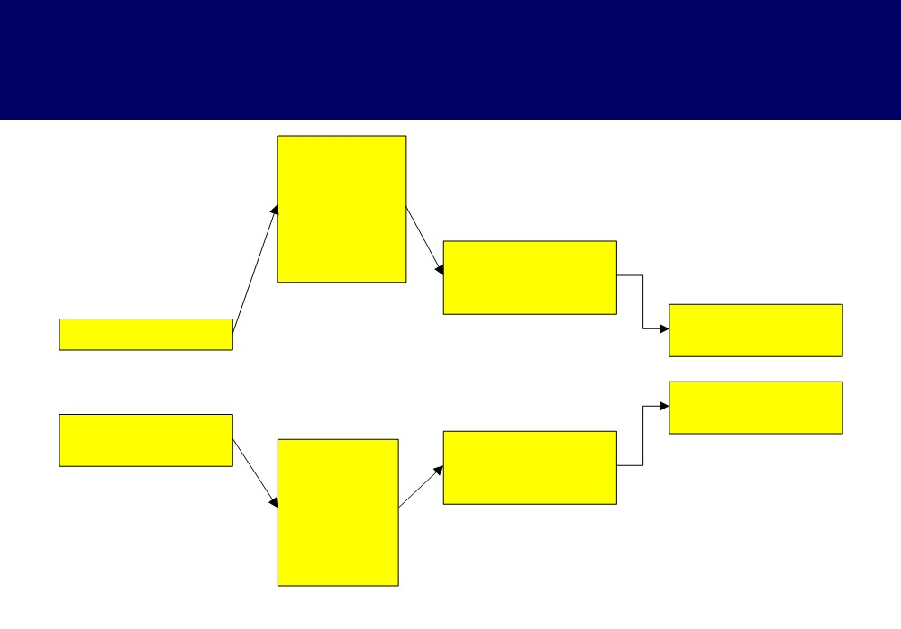
How culture values influence purchase decisions
Product
class choice criteria
(critical
product attributes)
Beliefs and
attitudes about product class
Product class selection
Terminal values
Brand class selection Beliefs and
Instrumental values
Brand choice criteria
attitudes about brand class
(critical brand attributes)

Slide 9
Levels of brand exposure
-
Power Brands
Brand power
-
Brands
-
Names
Local / Regional
National
Global
Market presence
Sustained effort will create not just names . . . but brands

Slide 10
Branding concepts - Identity and Image
Identity
Image
- Identity is on the sender’s side.
- Image is on the receiver’s side.
- The sender’s duty is to specify the meaning, intention and vocation of the brand.
- The image refers to the manner in which the public decodes all the signals emitted by the brand
through its products, services and communication program
- In brand management terms identity precedes image.
- It is a reception concept.

Slide 11
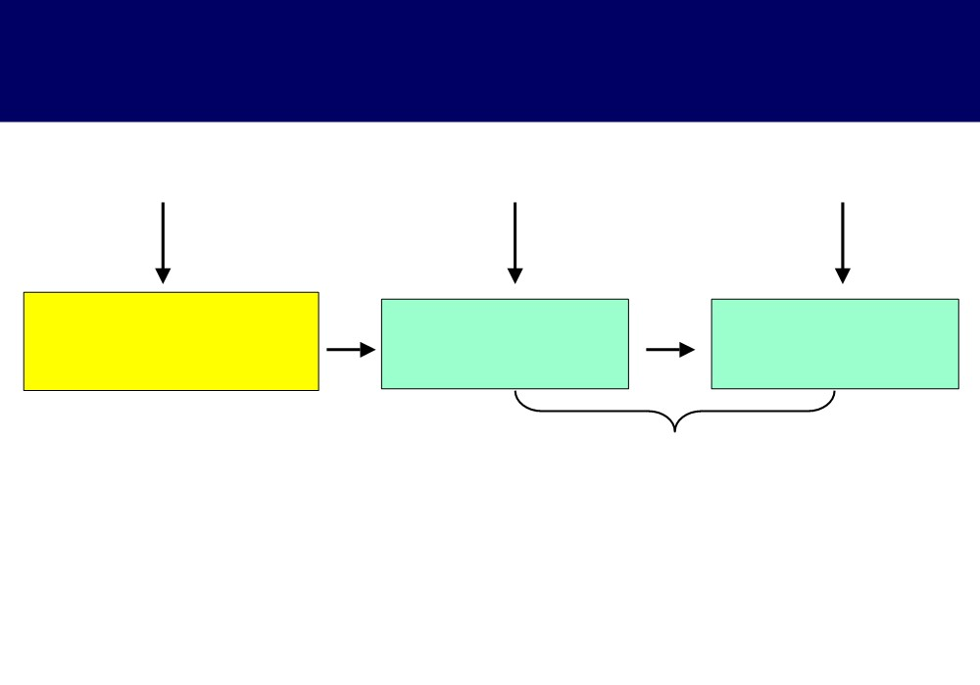
BRANDS - Identity and Image
Sending
Media
Receiving
Brand Identity
Signals
Brand Image
Transmitted
Competition and
Noise

Slide 12
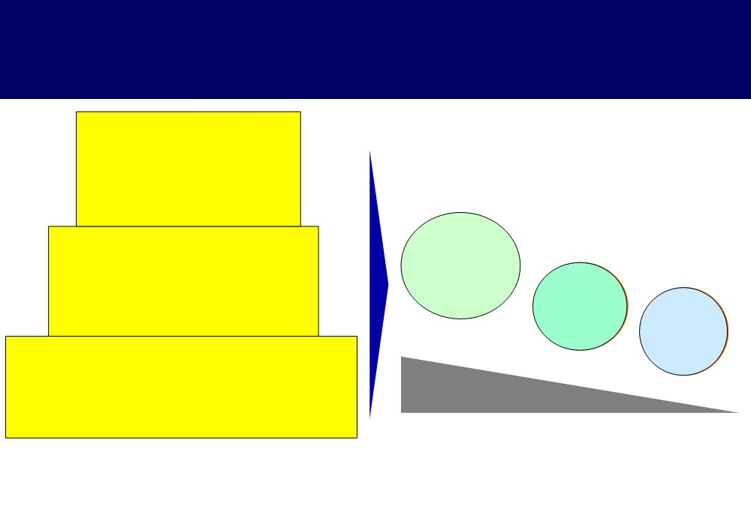
Brand power in degree
Brand insistence Ö stage of brand where the customer refuses to accept any other brand except
the preferred brand
Brand preference Ö stage of brand acceptance at which the consumer
Market universe
selects one brand over competing offerings
(All potential buyers of the product
Target buyers
based on previous experiences with that brand
(Buyers who start preferring
Brand
Brand recognition
a brand)
champions
Brand recognition Ö stage of brand acceptance at which the consumer knows of a brand but does not prefer it to competing brands
Brand preference
Brand insistence
Decreasing size of
the market

Slide 13
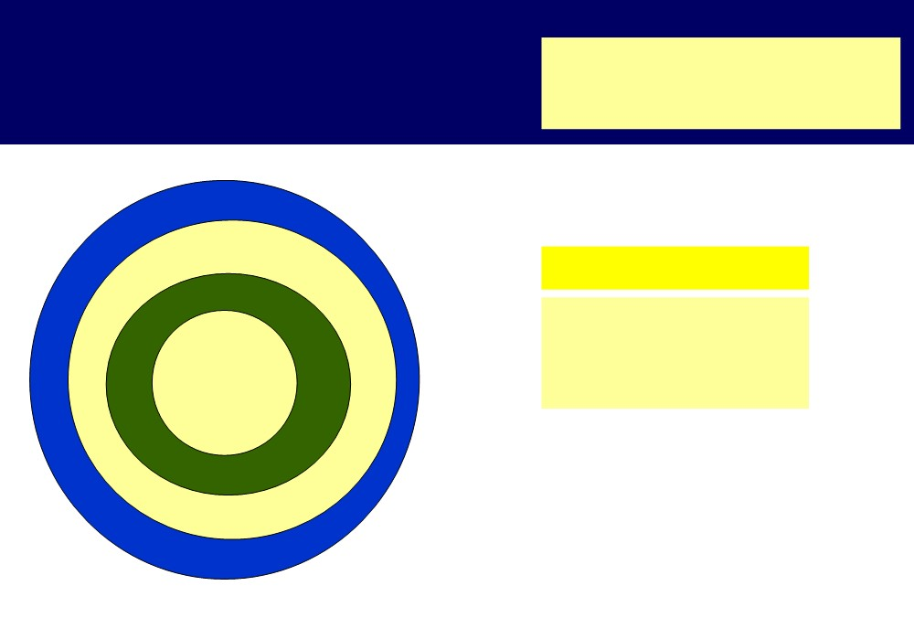
Creating Loyalty for the brand
Varying degrees of brand loyalty
Non-consumers
Price switchers
Fence sitters/ neutrals
Enhancing Loyalty
Passively loyal
Frequent-Buyer Programs, Customer Club, Database marketing etc
Committed

Slide 14
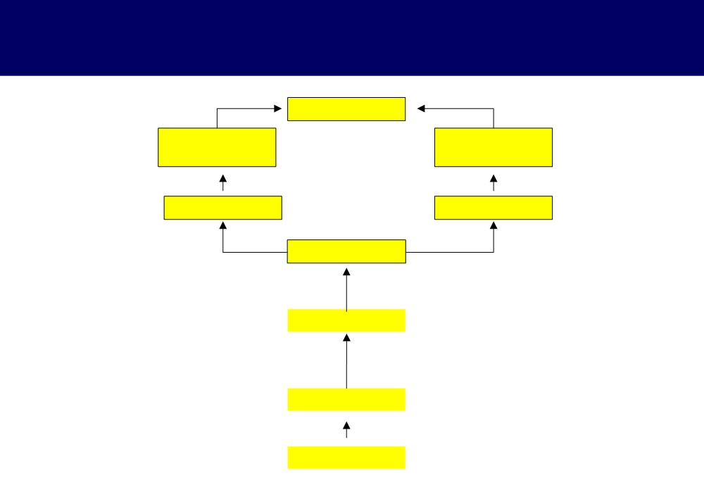
The Hierarchy of effects model of advertising
Brand loyalty
Belief
Attitude
reinforcement
reinforcement
Beliefs
Attitudes
Trials
Expectations
Awareness
Unawareness

Slide 15
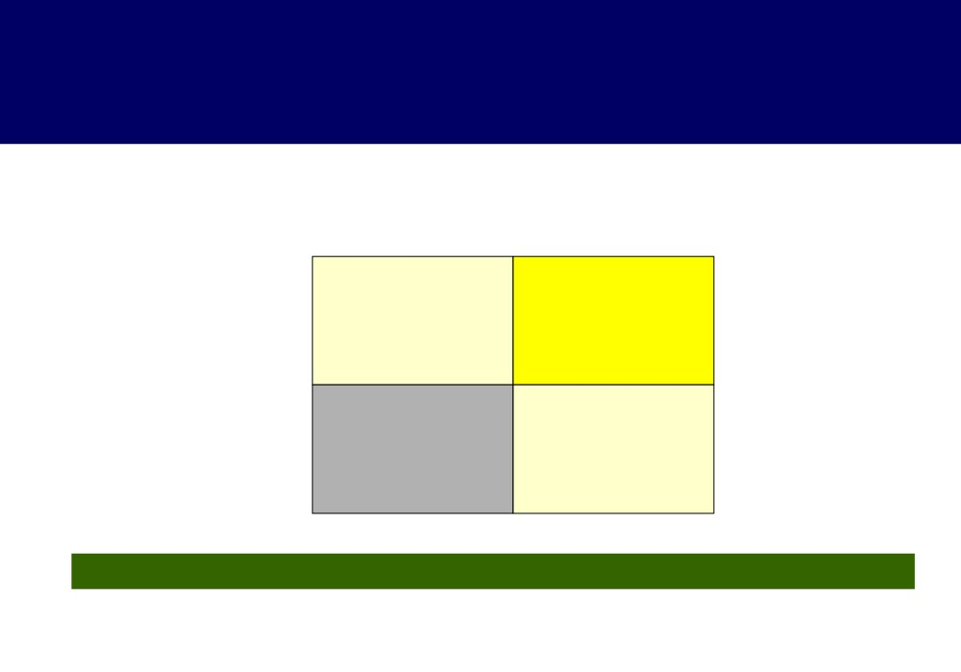
Brand equity affects buyer behavior
Recommends the brand to other buyers
No
Yes
Brand
Brand
Buys the brand
deserter
champion
Target buyer
Does not buy the brand
Non Trier
Brand apostle
Strongest branding effects are seen in the “brand apostle” stage

Slide 16
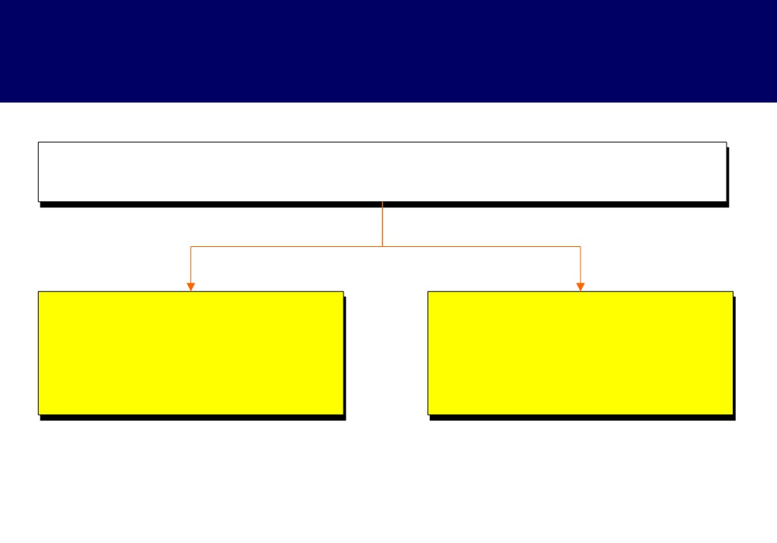
Brand Equity
Brand Equity is a set of assets (& liabilities) linked to the brand name & symbol that adds to (or subtracts from) the value provided by a product
Brand Equity is a set of assets,
Brand Equity adds value to the
thus management of
consumer and the firm
brand equity involves investment
to create and enlarge these assets

Slide 17
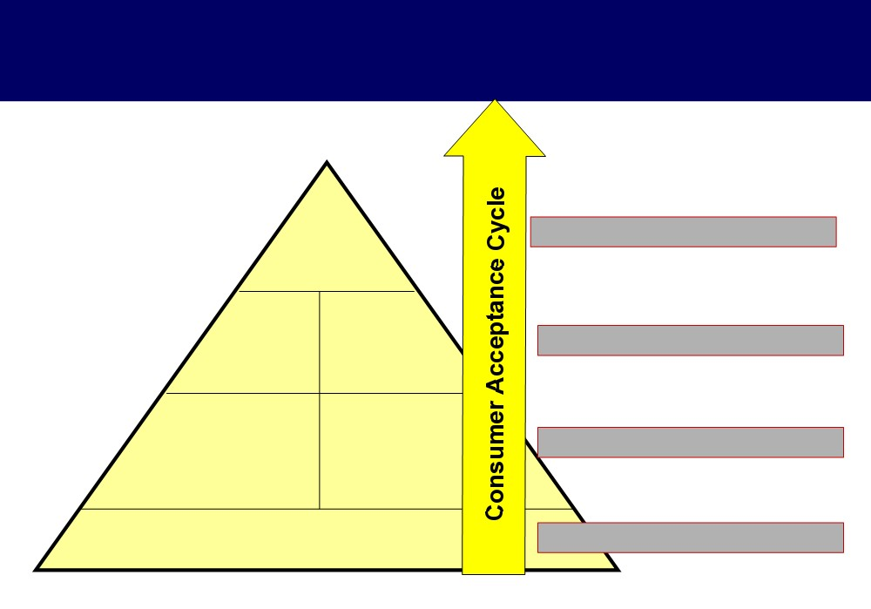
Consumer-Based Brand Equity Pyramid
Consumer- Brand
4 Intense, Active Loyalty
Resonance
Consumer Consumer
3 Positive Accessible Reactions
Judgement Feelings
Brand Brand
2 Points of Difference
Performance Imagery
Brand Salience
1 Deep Broad Brand Awareness

Slide 18
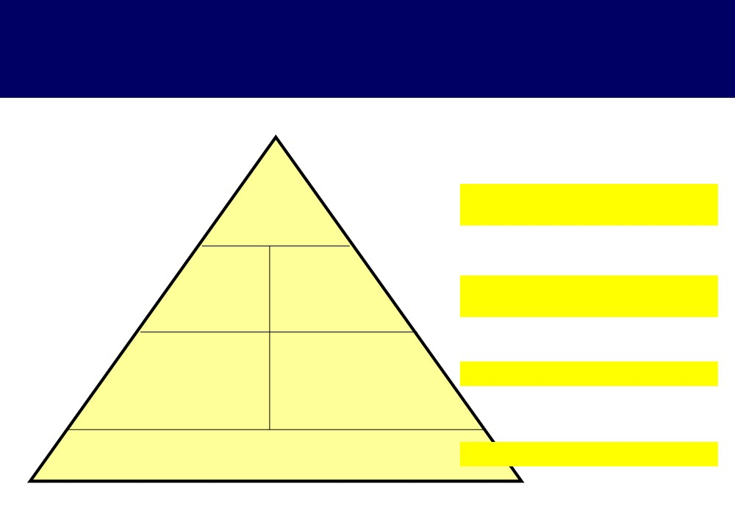
Consumer-Based Brand Equity Pyramid
Resonance
Loyalty
4 Brand Relationships (WHAT About You AND ME?)
Attachment Community Engagement
Warmth, Fun
Feelings
Quality
Judgement Credibility
Excitement,
3 Brand Response (WHAT About
Consideration Superiority
Security, Social
Approval, You?)
Self-Respect
Performance
Brand Characteristics & Secondary Features Product Reliability,
User Profiles
Imagery
Purchase and Usage Situations
Durability & Serviceability Service Effectiveness,
2 Brand Meaning (WHAT Are You?)
Personality & Values History, Heritage, & Experiences
Efficiency & Empathy Style and Design; Price
Category Identification Needs Satisfied
1 Brand Identity (WHO Are You?)
Salience

Slide 19
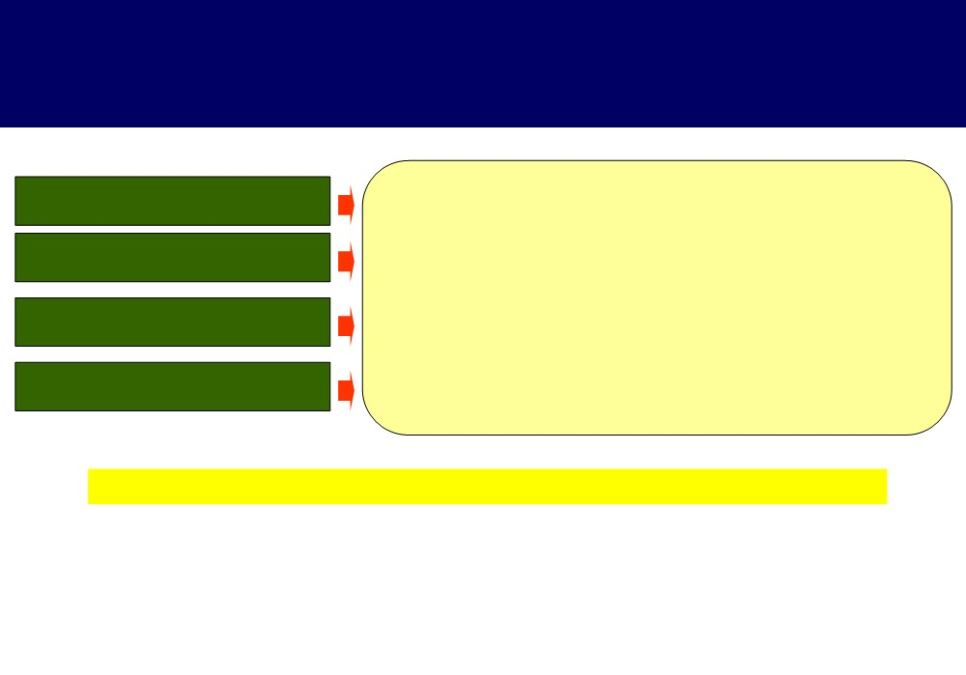
How does the brand relate to the customer?
Differentiation
How distinctive is the brand is in the market place?
Relevance
Is it meaningful to him or her ? Is it personally appropriate ?
Esteem
Is the brand held in high regard and considered the best in its class?
Knowledge
Does the customer understand as to what a brand stands for?
Brand Power = Differentiation x Relevance X Esteem X Knowledge

Slide 20
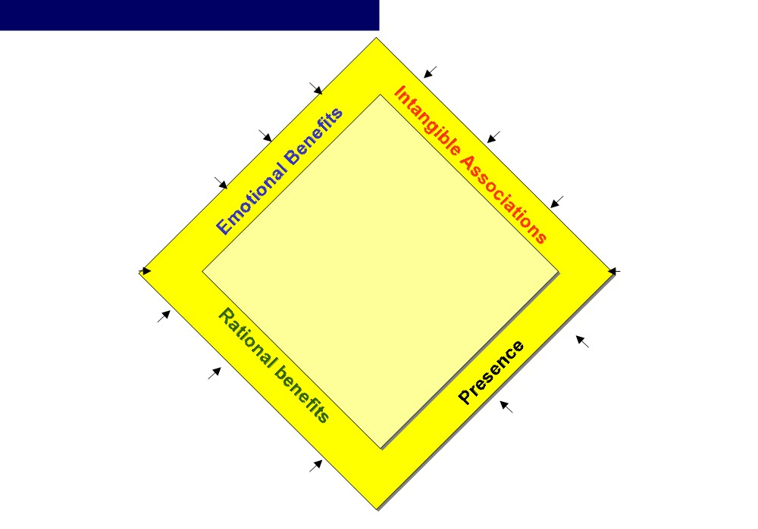
Brand Equity elements : Luxury car - McKinsey & Co
Internal
“European / Japanese”
“makes me feel pampered”
External
Reputation
“tells others that I am successful”
“Design and performance”
Evolution
Perceived value
“Will become the leader in high- performance machines””
”very expensive, but worth it”
What the Brand
Brand Who the
brand offers
brand is
benefits
identity
Functional
“easy in driving”
Activities
Process
“Sponsors premier racing events”
“Dealer network that knows my profile wherever I go”(Toyota)
Presentation
Relationship
“has distinct logo incorporated into select design elements
“Has related affinity
(e.g.Wheels of the car)
programs I like” (Mercedes Clubs)

Slide 21
The three variables in the brand anatomy (Young and Rubicam model)
Differentiation X Relevance = Brand Strength.
Esteem X Knowledge = Brand Stature.
Comparing Esteem & Knowledge: >> Some brands rank higher in
esteem than in knowledge. This means relatively few people
>> If there is no point of difference, a brand’s value will be low.
>> Esteem combines perceived quality with perceptions of a
understand what the brand stands for, but those who do hold it in
growth or decline in popularity.
high regard.
>> Relevance comes next. Unless a brand is relevant to a significant segment, it will not attract a large customer base.
>> Knowledge indicates that the customer not only is aware of the brand but also
>> Conversely a brand may have high knowledge but low esteem. This means that more people know what the brand stands for, but relatively few hold it in high regard.
understands what the brand stands for.

Slide 22
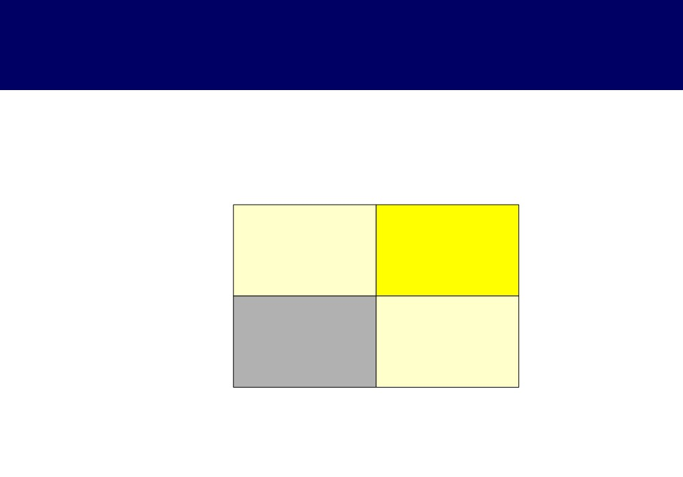
The Y&R grid
Brand Stature (Knowledge and Esteem)
Low
High
High Brand
Swatch watches
Disney Sony
Differentiation and relevance
Low
Starbucks coffee
Bayer Oldsmobile

Slide 23
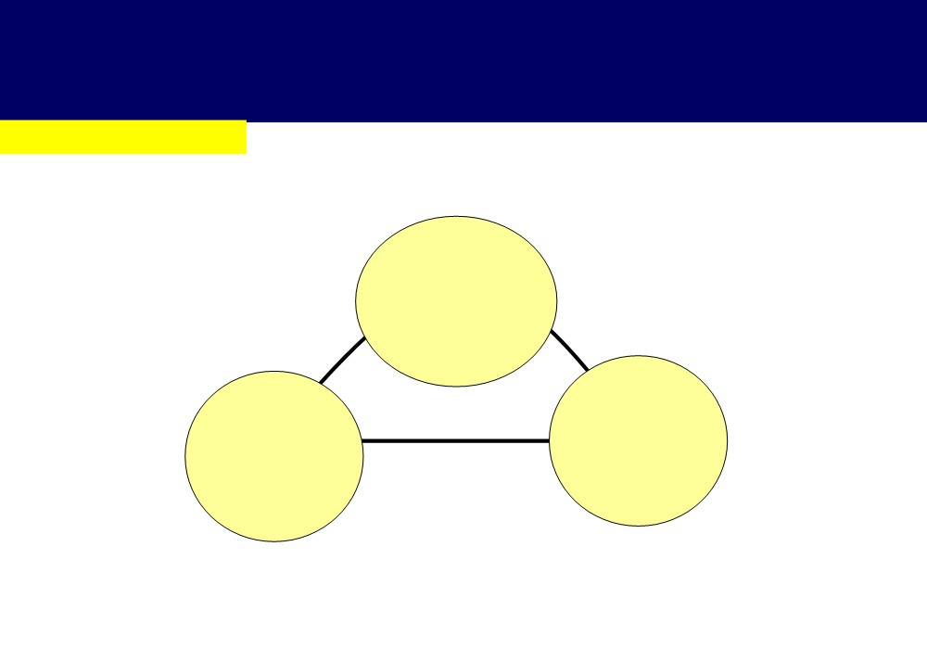
Aaker’s Brand equity is based on understanding of the following critical areas ...
Leadership / Popularity
Brand Leadership has three key dimensions ...
People want to be
apart of the
bandwagon and are uneasy
against the flow
A brand can move head
It reflects in part the
technologically
“number one syndrome”.
LG leader in Plasma TV

Slide 24
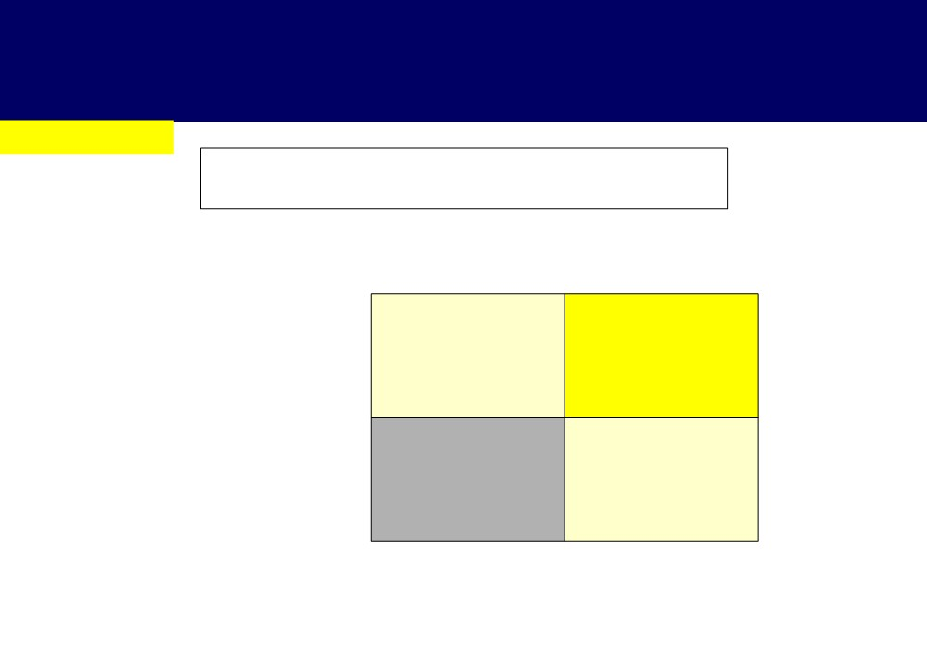
Aaker’s Brand equity is based on understanding of the following critical areas ...
Perceived value
Perceived value is mentioned along the following dimensions ...
Whether the brand proves good value for the money
No
Yes
Comparatively superior brands
Winner brands
Yes
Whether there is a reason to buy this brand over others
No
Loser brands
Non differentiated brands

Slide 25
Aaker’s Brand equity is based on understanding of the following critical areas ...
Brand Personality
Organizational Associations
This brand is made by an organization I would trust
Brand Personality provides links to the brand’s emotional
I admire the brand “X” organization
and self expressive benefits as well as a basis for
brand-customer relationship and differentiation
I would be proud (or pleased) to do business with the brand TATA’s as an organization

Slide 26
Aaker’s Brand equity is based on understanding of the following critical areas ...
Brand Awareness
Awareness reflects the presence of the brand in the mind of Customers
• Recognition: “Have you heard of the Buick Roadmaster”.
• Recall: “ What brands of car can you recall ? ”
• Graveyard statistics: “recall level of those who recognize the brand”. “How much do you recall?” Fully or Partially.
• Top-of-Mind : “the first named brand in a recall task”.
• Brand dominance : “ the only brand recalled ”.
• Brand Familiarity : “ the brand is familiar ”.
• Brand knowledge or salience: “ you have an opinion about the brand ”.

Slide 27
BRANDS - Brand Positioning
Brand Positioning applies to a process of emphasizing the brands distinctive and motivating attributes in the light of competition.
It refers to what product segment does the brand belong and what is its specific difference.
It is based on an analysis of response to the following 4 questions
Why?
For Whom?
When?
Against Whom?

Slide 28
BRANDS - Brand Positioning
1) Why or for what? What is the specific consumer benefit or exclusive motivating attribute justifying the brand. e.g. Sony - Innovation
2) For Whom? This indicates a target. e.g.- 7 Up- Teenagers, Canada Dry- Adults
3)When? Indicates the occasion on which to use the product. e.g. Titan as gift.
4) Opposed to Whom? Points to the main competition, those brands from one whom the one aspires to capture the clientele.
e.g.- Pepsi Challenge and the Uncola campaign- 7Up

Slide 29
Nike: Building a Global Brand

Slide 30
How would you characterize Nike’s brand image and sources of brand equity in the U.S?
high performance brand
innovative image
brand associated

Slide 31
The sources of Nike brand equity in US arises from the Aaker model form the following:

Slide 32
The core of building the brand equity for Nike brand equity is
brand association. Nike is associating its brand with famous athletic celebrities that have similar personality as the brand
brand awareness. Nike communicated this association through their TV ads that was a hit at their time in the states like the Jordan air ad that caught fire and increased their sales dramatically
perceived quality of the brand not only among athletes but also between the public
brand credibility as a brand which was established over the years through their commitment to delivering what they promise
good relationship with its consumers
brand loyalty

Slide 33
How might Nike’s effort to become a global corporation affect its sources of equity and brand image in the U.S, Europe and Asia ?

Slide 34
Nike and the USA market
sources of brand equity of Nike are Brand association with famous American athletes, Sponsorship programs for major sports events in the US, their massive and aggressive “provoking and unique” IMC that creates high brand awareness through TV ads and advertizing campaigns, and finally the perceived quality of the product in addition to a good CRM program
superman values

Slide 35
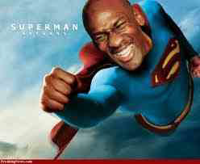

Slide 36
Nike and the European market

Slide 37
Nike’s brand image was perceived negatively as a fashionable aggressive and arrogant brand rather a performance innovative one
Also Nike found that European prefer different types of sports; soccer, field and track games and not Basketball which was associated with Nike
the aggressive provoking communication of Nike was not accepted by many Europeans
presence of the Nike’s logo, the swoosh, as an American symbol, was very irritating to Europeans
they were perceived as a fashion-oriented and not performance oriented, irrelevant to the European market, aggressive American brand

Slide 38
Glocalized strategy in building their global brand equity
They kept the essence of the brand in terms of a consistent brand name and brand logo as a part of the global myth effect. They focused on the main core values of their brand as part of their global positioning which is the performance and innovation
They retrieved about 90% control over their brand distribution and marketing and advertising activities in Europe in order to maintain the same global image and brand positioning.
famous European soccer players like Eric cantona and Roberto Mandeni
they sponsored local soccer teams like Paris saint Germain and Borussia Dortmund

Slide 39
lowered the aggressive tone used in their advertizing and reverted to a more kinder, and gentle marketing approach using globally accepted and appealing celebrities like Jordan , tiger wood, Brazilian soccer star Romario to project a more global and international image on their brand.
increase their global appeal they engaged in sponsoring big global events like the Barcelona Olympics 1992, and the world cup
decrease their provoking and aggressive corporate philosophy that was featured in their expensive and provoking sponsorship and endorsement contracts in addition to the overwhelming abundance of their swoosh over their products everywhere which was known as the “Swooshification of the world”
show more commitment to global social issues

Slide 40
Nike and the Asian market

Slide 41
they launched an initiative marketing campaign under the slogan”It’s my turn” showing their commitment to Asia
debugged a new affordable series of Nike products for the Asian consumer “play series 100
they constructed playgrounds, called the play zones for use by youth.
increasing their brand awareness, they are planning to sponsor the 2002 world cup in Korea and Japan and the 2000 Olympics in Sydney.

Slide 42
what effect would Nike becoming an official sponsor for the Olympics have on the company’s relationship with consumers?
Nike has built a strong brand image along the years through successful brand associations with legendary athletic heroes (American and non Americans).
conveys the brand personality and shapes the brand image in the mind of the consumer
The successful brand association strategy of Nike is based on three main pillars, the attractiveness of the celebrity, the credibility of the celebrity and the personality match between the celebrity and the brand
Nike selected endorsers who have a high credibility level among the target audience
Finally Nike ensured the existence of a significant match between the brand and the celebrity in terms of identity, personality, positioning in the market

Slide 43
Point of strength in Nike endorsement strategy
Consistency and long-term commitment.
monitoring the behavior, conduct and public image
selection of unique celebrities
brand association with celebrities on two tier
sponsoring big events, like the Olympics
increase the global brand 12 awareness

