Slide 1
Chapter 1:
New Perspectives On
Marketing in the
Service Economy

Slide 2
Overview of Chapter 1
Why Study Services?
What are Services?
Marketing Challenges Posed by Services
Extended Marketing Mix Required for Services
Integration of Marketing with Other Management Functions
Developing Effective Service Marketing Strategies

Slide 3
Why Study Services?

Slide 4
Why Study Services?
Services dominate most economies and are growing rapidly:
Services account for more than 60% of GDP worldwide
Almost all economies have a substantial service sector
Most new employment is provided by services
Strongest growth area for marketing
Understanding services offers you a personal competitive advantage

Slide 5
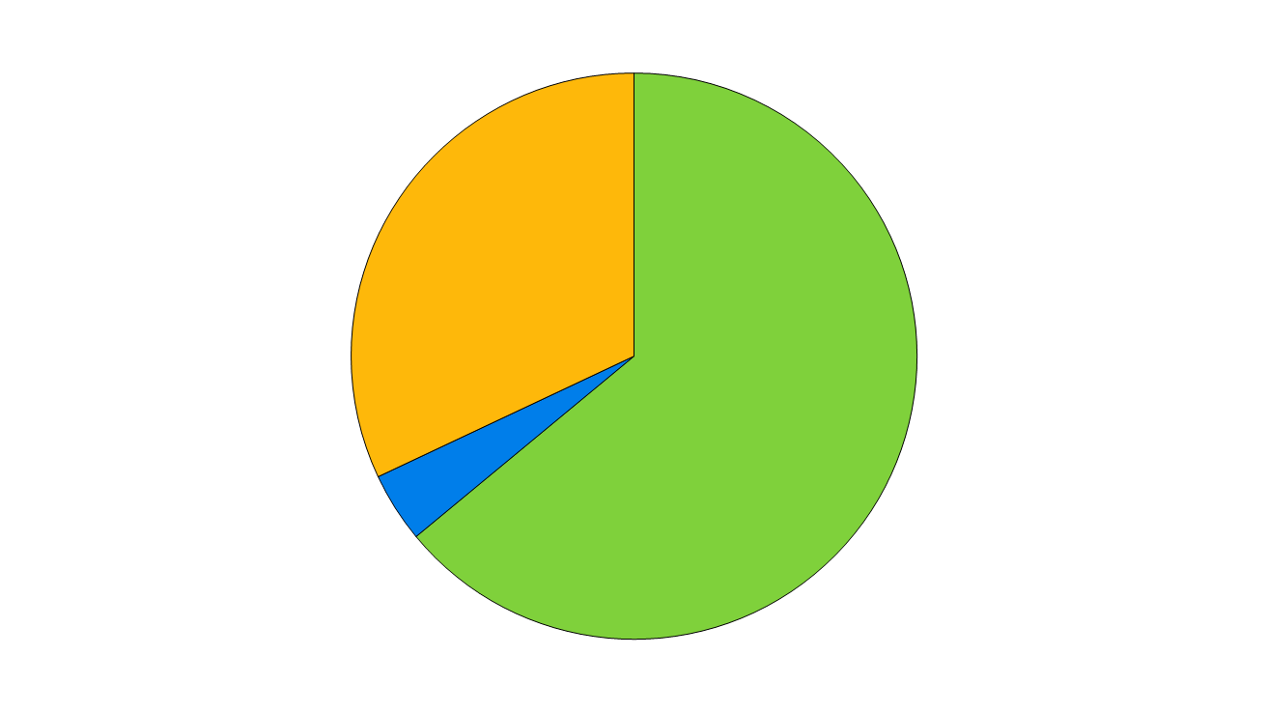
Services Dominate the Global Economy
Contribution of Service Industries to GDP Globally
Manufacturing 32%
Services 64%
Agriculture 4%
Source: The World Factbook 2008, Central Intelligence Agency

Slide 6
Value Added by Service Industry Categories to U.S. GDP
Business Services 12%
Transport, Utilities & Communications
9%
SERVICES
Wholesale & Retail Trade 12%
Source: US Bureau of Economic Analysis, Industry Economics Accounts, 2007

Slide 7
Why Study Services?
Most new jobs are generated by services
Fastest growth expected in knowledge-based industries
Significant training and educational qualifications required, but employees will be more highly compensated
Will service jobs be lost to lower-cost countries? Yes, some service jobs can be exported

Slide 8
Changing Structure of Employment as Economies Develop
Agriculture
Services
Share of
Employment
Industry
Time, per Capita Income
Source: IMF, 1997

Slide 9
Why Study Services?
Powerful forces are transforming service markets
Government policies, social changes, business trends, advances in IT, internationalization
Forces that reshape:
Demand increased
Supply more alternatives
The competitive landscape tough
Customers’ choices, power, and decision making more strong

Slide 10
Transformation of the Service Economy
Social
Changes
Business
Trends
Advances
In IT
Government
Policies
Globalization
New markets and product categories
Increase in demand for services
More intense competition
Innovation in service products & delivery systems, stimulated by better technology
Customers have more choices and exercise more power
Success hinges on:
Understanding customers and competitors
Viable business models
Creation of value for customers and firm
Increased focus on services marketing and management

Slide 11
Factors Stimulating Transformation of the Service Economy
Social
Changes
Business
Trends
Advances
In IT
Government
Policies
Globalization
Changes in regulations
Privatization
New rules to protect customers, employees, and the environment

Slide 12
Factors Stimulating Transformation of the Service Economy
Social
Changes
Business
Trends
Advances
In IT
Government
Policies
Globalization
Rising consumer expectations
More people short of time
Increased desire for buying experiences vs. things
Easier access to information

Slide 13
Factors Stimulating Transformation of the Service Economy
Social
Changes
Business
Trends
Advances
In IT
Government
Policies
Globalization
Push to increase shareholder value
Emphasis on productivity and cost savings
Manufacturers add value through service and sell services
More strategic alliances and outsourcing
Focus on quality and customer satisfaction
Growth of franchising

Slide 14
Factors Stimulating Transformation of the Service Economy
Social
Changes
Business
Trends
Advances
In IT
Government
Policies
Globalization
Growth of Internet
Greater bandwidth
Compact mobile equipment
Wireless networking
Faster, more powerful software
Digitization of text, graphics, audio, video

Slide 15
Factors Stimulating Transformation of the Service Economy
Social
Changes
Business
Trends
Advances
In IT
Government
Policies
Globalization
More companies operating on transnational basis
Increased international travel
International mergers and alliances
“Offshoring” of customer service
Foreign competitors invade domestic markets

Slide 16
What are Services?

Slide 17
What Are Services?
The historical view
Smith (1776): Services are different from goods because they are perishable
Say (1803): As services are immaterial, consumption cannot be separated from production
A fresh perspective: Benefits without Ownership
Rental of goods:
(a) Payment made for using or accessing something – usually for a defined period of time – instead of buying it outright and

Slide 18
What Are Services?
Five broad categories within non-ownership framework of which two or more may be combined
Rented goods services
e.g Fancy dress
Defined space and place rentals
e.g Resturent
Labor and expertise rentals
Consultancy, cleaning house
Access to shared physical environments
Trade show, them parks
Access to and usage of systems and networks Banks telecommunication

Slide 19
Definition of Services
Services
are economic activities offered by one party to another
most commonly employ time-based performances to bring about desired results
In exchange for their money, time, and effort, service customers expect to obtain value from
access to goods, labor, facilities, environments, professional skills, networks, and systems;
normally do not take ownership of any of the physical elements involved.

Slide 20
Value Creation is Dominated by Intangible Elements
Physical Elements
High
Salt
Detergents
CD Player
Wine
Golf Clubs
New Car
Tailored clothing
Plumbing Repair
Fast-Food Restaurant
Health Club
Airline Flight
Landscape Maintenance
Consulting
Life Insurance
Internet Banking
Low
High
Intangible Elements
Source; Adapted from Lynn Shostack

Slide 21
Service Products vs. Customer Service & After-Sales Service
A firm’s market offerings are divided into core product elements and supplementary service elements
Need to distinguish between:
Marketing of services – when service is the core product
Marketing through service – when good service increases the value of a core physical good
Manufacturing firms are reformulating and enhancing existing added-value services to market them as stand-alone core products

Slide 22
Service – A Process Perspective
Differences exist amongst services depending on what is being processed
Classification of services into
People processing
Possession processing
Mental stimulus processing
Information processing

Slide 23
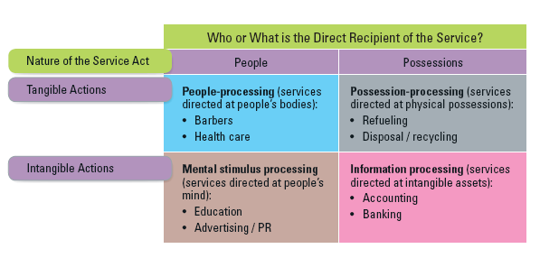
4 Categories of Services

Slide 24
People Processing
Customers must:
physically enter the service factory
cooperate actively with the service operation
Managers should think about process and output from the customer’s perspective
to identify benefits created and non-financial costs: Time, mental and physical effort

Slide 25
Possession Processing
Involvement is limited
Less physical involvement
Production and consumption are separable

Slide 26
Mental Stimulus Processing
Ethical standards required:
Customers might be manipulated
Physical presence of recipients not required
Core content of services is information-based
Can be ‘inventoried’

Slide 27
Information Processing
Most intangible form of service
May be transformed:
Into enduring forms of service output
Line between information processing and mental stimulus processing may be unclear

Slide 28
Marketing Challenges Posed by Services

Slide 29
Services Pose Distinctive Marketing Challenges
Marketing management tasks in the service sector differ from those in the manufacturing sector.
Eight common differences between services and goods but they do not apply equally to all services
What are marketing implications of these differences?

Slide 30
Differences, Implications, and Marketing-Related Tasks
Difference
Most service products
cannot be inventoried
Intangible elements
usually dominate
value creation
Services are often
difficult to visualize &
understand
Customers may be
involved in co-
production
Implications
Customers may be
turned away
Harder to evaluate
service & distinguish
from competitors
Greater risk &
uncertainty perceived
Interaction between
customer & provider;
poor task execution
could affect satisfaction
Marketing-Related Tasks
Use pricing, promotion,
reservations to smooth
demand; work with ops to
manage capacity
Emphasize physical clues,
employ metaphors and vivid
images in advertising
Educate customers on
making good choices; offer
guarantees
Develop user-friendly
equipment, facilities &
systems; train customers,
provide good support

Slide 31
Differences, Implications, and Marketing-Related Tasks
Difference
People may be part of
service experience
Operational inputs and
outputs tend to vary
more widely
Time factor often
assumes great
importance
Distribution may take
place through
nonphysical channels
Implications
Behavior of service
personnel & customers
can affect satisfaction
Hard to maintain quality,
consistency, reliability
Difficult to shield
customers from failures
Time is money;
customers want service
at convenient times
Electronic channels or
voice communications
Marketing-Related Tasks
Recruit, train employees to
reinforce service concept
Shape customer behavior
Redesign for simplicity and
failure proofing
Institute good service
recovery procedures
Find ways to compete on
speed of delivery; offer
extended hours
Create user-friendly,
secure websites and free
access by telephone

Slide 32
Extended Marketing Mix for Services

Slide 33
Services Require An Extended Marketing Mix
Marketing can be viewed as:
A strategic and competitive thrust pursued by top management
A set of functional activities performed by line managers
A customer-driven orientation for the entire organization
Marketing is only function to bring operating revenues into a business; all other functions are cost centers
The “7 Ps” of services marketing are needed to create viable strategies for meeting customer needs profitably

Slide 34
The 7Ps of Services Marketing
Traditional Marketing Mix Applied to Services
Product (Chapter 4)
Place and Time (Chapter 5)
Price (Chapter 6)
Promotion and Education (Chapter 7)
Extended Marketing Mix for Services
Process (Chapter 8 & 9)
Physical Environment (Chapter 10)
People (Chapter 11)

Slide 35
Integration of Marketing with Other Management Functions

Slide 36
Marketing to be Integrated with Other Management Functions
Three management functions play central and interrelated roles in meeting needs of service customers
Operations
Management
Marketing
Management
Customers
Human Resources
Management

Slide 37
Developing Effective Service Marketing Strategies

Slide 38
Overview of Framework
Understanding Service Products, Consumers and Markets
Part I: Chapters 1-3
Applying the 4 P’s of Marketing to Services
Part II: Chapters 4-7
The Extended Services Marketing Mix for Managing the Customer Interface
Part III: Chapters 8-11
Implementing Profitable Service Strategies
Part IV: Chapters 12-15

Slide 39
Framework - Part I
Understanding Service Products, Consumers, and Markets
Chapter 1 New Perspectives on Marketing in the Service Economy
Chapter 2 Consumer Behavior in a Services Context
Chapter 3 Positioning Services in Competitive Markets

Slide 40
Framework - Part II
Applying the 4 P’s of Marketing to Services
Chapter 4 Developing Service Products: Core and Supplementary Elements
Chapter 5 Distributing Services through Physical and Electronic Channels
Chapter 6 Setting Prices and Implementing Revenue Management
Chapter 7 Promoting Services and Educating Customers

Slide 41
Framework - Part III
The Extended Services Marketing Mix for Managing the Customer Interface
Chapter 8 Designing and Managing Service Processes
Chapter 9 Balancing Demand and Productive Capacity
Chapter 10 Crafting the Service Environment
Chapter 11 Managing People for Service Advantage

Slide 42
Framework - Part IV
Implementing Profitable Service Strategies
Chapter 12 Managing Relationships and Building Loyalty
Chapter 13 Complaint Handling and Service Recovery
Chapter 14 Improving Service Quality and Productivity
Chapter 15 Striving for Service Leadership

Slide 43
Summary
Why Study Services?
Unique Characteristics
Services dominate the economy in many nations. The majority of jobs are created in the service sector.
Services are often intangible, difficult to visualize and understand, and customers may be involved in co-production.
CHAPTER 1
Services are a form of rental (not ownership). They are performances that bring about a desired result.
Product, Place & Time, Price, Promotion & Education, Process, Physical Environment, People
Extended Marketing Mix
What are Services?

